Slide 1
Stories
by Adya Aswin

Slide 2

What are stories?
Stories = Stories are real life experiences or imaginary experiences written to be read or told.

Slide 3

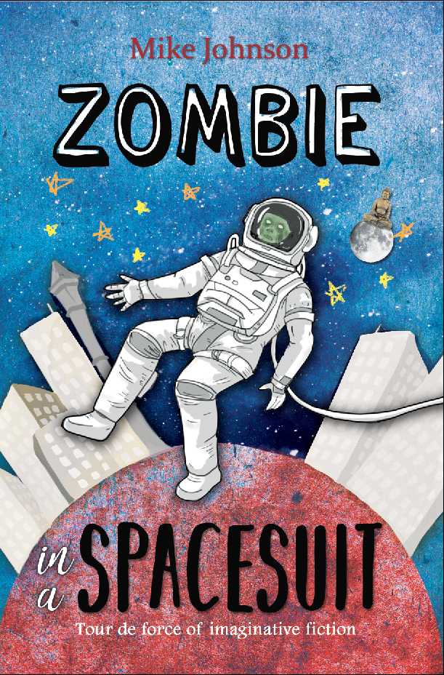
Genre
What is a genre = Genre is something that gives a book a topic .
The two main genre are fiction and non-fiction.
Fiction – made up or imaginary
Non-fiction – real incidents, important facts or information

Slide 4
Example of fiction genres
Fantasy = Books that have fairies, princesses, princes and many other different forms of humans.
Mystery = Books that is with lots of clues that will be solved.
Comics = books written in speech bubbles.

Slide 5



Books in fiction
Mystery
Fantasy
Comics
The Thea sisters books
Alice in wonderland

Slide 6
Examples of Non – fiction genre
History = incidents in the past.
Auto-Biography = when somebody writes about their own life.
Biography = when somebody writes about another person’s life.
Informational = facts or information of nature

Slide 7
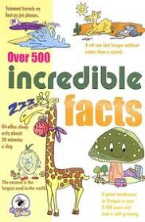

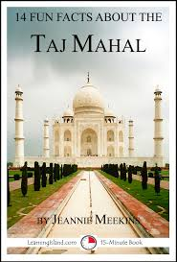
informational
Books in non- fiction
Auto biography
history
Incredible facts
Vincent Van Gogh
Taj Mahal

Slide 8

Why do we need stories
We need stories because it helps our vocabulary, improves our creative skills, also we will know many facts and different cultures.

Slide 9

Thank you

